Slide 1

Monthly Expenses Analysis
An excel project using pivot tables and charts

Slide 2

Problem Statement
Scenario: Nitin works as a graphic designer with a monthly income of ₹15,000. To meet his daily commuting needs, he is planning to purchase a scooter.
The Challenge :Despite having a clear financial goal, Nitin has failed to save money over the past two months due to a lack of visibility into his monthly expenses. Without clear insights into his spending patterns, he is unable to identify cost-cutting opportunities to fund the purchase of a scooter.
Objective: Develop a solution that helps Nitin track his expenses, identify unnecessary spending, and increase his savings to successfully purchase a scooter.

Slide 3

Month-wise trend of expenses(pivot table &chart) ➡️Find out the month Nitin spent the most
months | Sum of Expense (INR)
January | 13900
February | 15620
March | 13140
April | 14800
May | 13370
June | 13560
Grand Total | 84390
In “FEBRUARY” Nitin spent the most

Slide 4

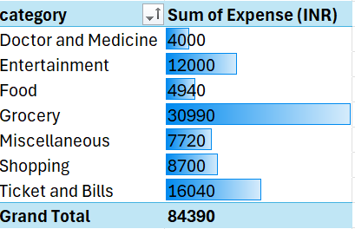
➡️Category wise Expenses ➡️visually represent it with data bars to display categories with the highest and lowest expense amount

Slide 5

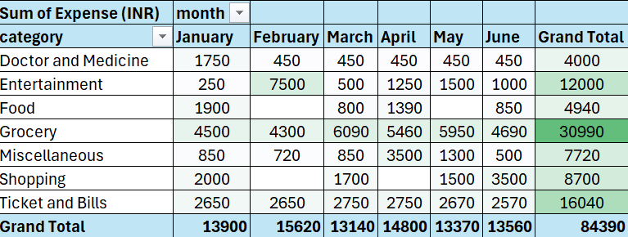
➡️Month wise expenses of each category(pivot table) ➡️find out 2 categories with higher expenses for each of the 6 months

Slide 6

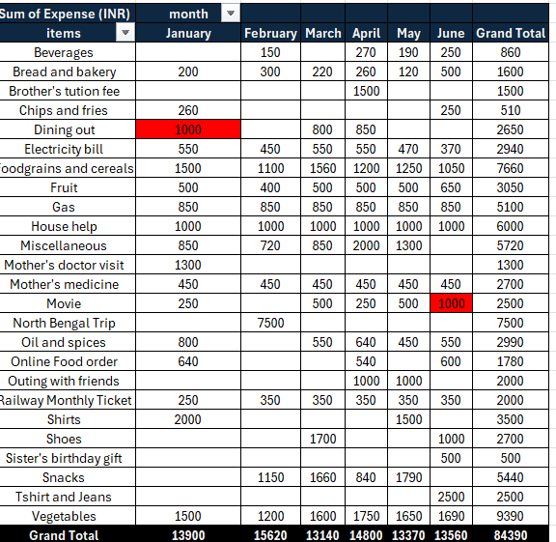
➡️How much is spent in each month against different items of entertainment ,food ,shopping categories(pivot table) ➡️find out which months have the highest amount spent for movies and dining out

Slide 7

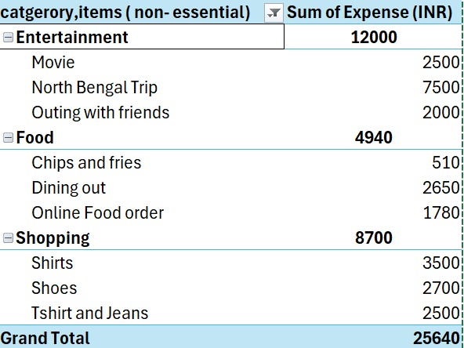
➡️Identify major discretionary spending ➡️Recommended how can Nitin increase his savings
These areas are where savings can be targeted

Slide 8

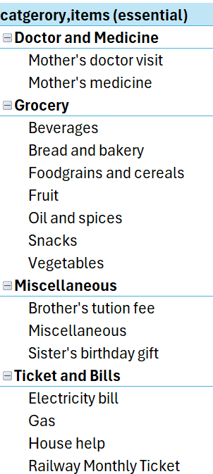
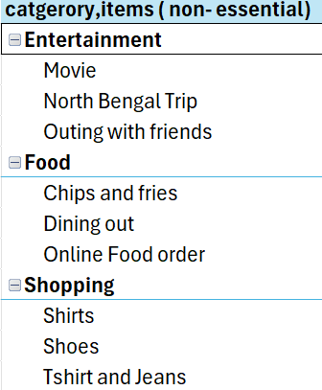
➡️Decide analysis based on the essential and less essential category and items

Slide 9
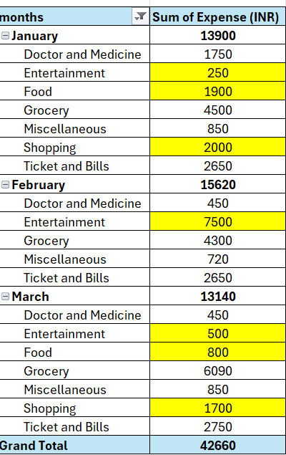
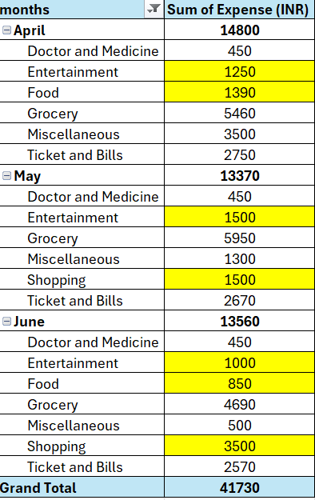
Month wise expenses based on category
(Highlighting non - essential expenses)

Slide 10

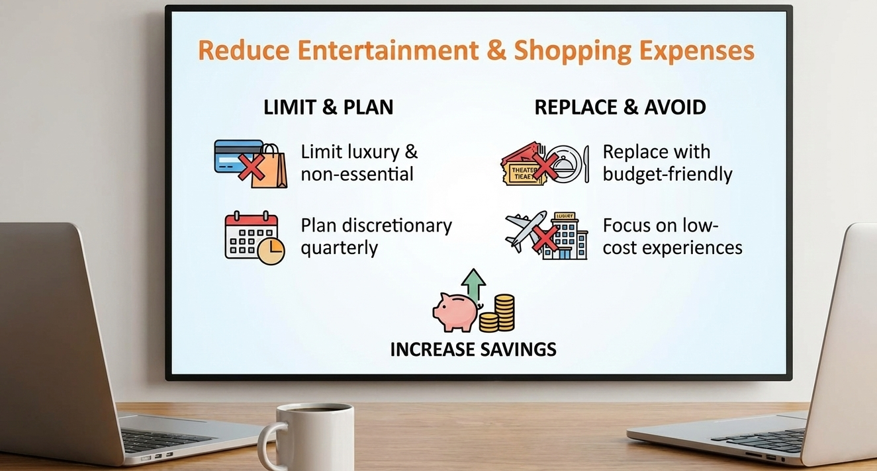
Recommendations to Improve Monthly Savings
Limit luxury and non-essential shopping
Plan discretionary purchases quarterly instead of monthly
Replace costly leisure activities with budget-friendly alternatives
Avoid high-expense trips and focus on low-cost experiences

Slide 11

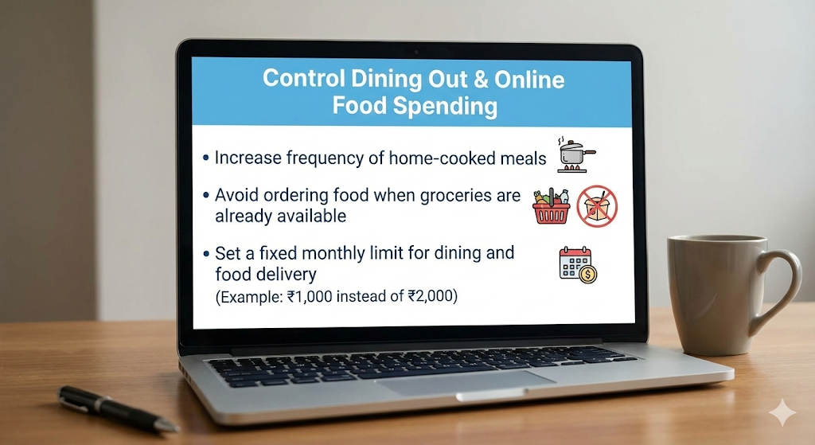
➡️Control Dining Out & Online Food Spending ➡️Increase frequency of home-cooked meals ➡️avoid ordering food when groceries are already available ➡️Set a fixed monthly limit for dining and food delivery (Example: ₹1,000 instead of ₹2,000)

Slide 12

➡️Identify and reduce impulse spending
➡️Avoid unnecessary gifts and unplanned expenses
➡️Control transportation and small daily expenses
➡️Allocate a monthly budget for miscellaneous items (₹500–₹700)

Slide 13

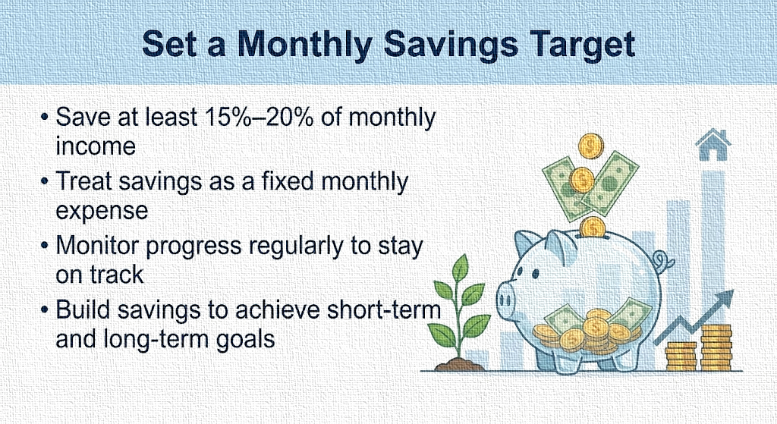
➡️Save at least 15%–20% of monthly income
➡️Treat savings as a fixed monthly expense
➡️Monitor progress regularly to stay on track
➡️Build savings to achieve short-term and long-term goals

Slide 14

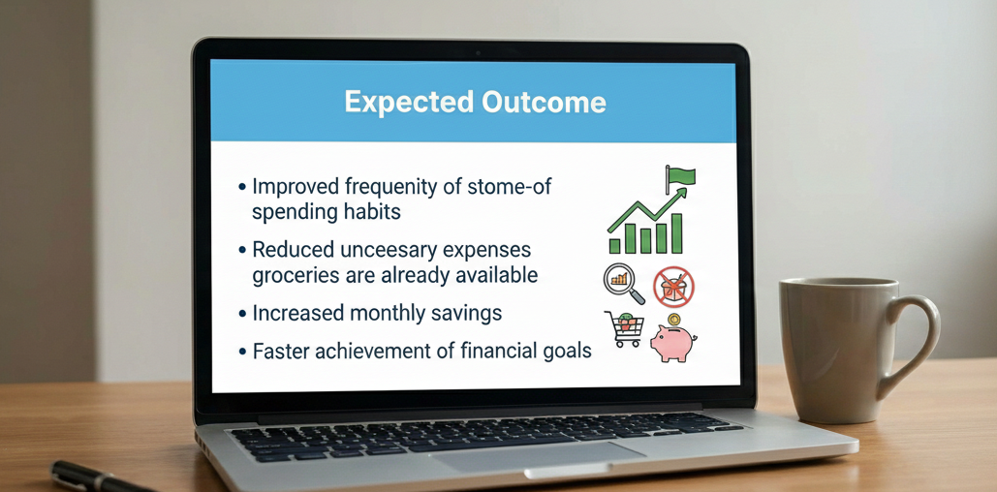
➡️Improved visibility of spending habits
➡️Reduced unnecessary expenses
➡️Increased monthly savings
➡️Faster achievement of financial goals😊

Slide 15

THANK YOU

